Slide 1


Using lotteries in Australia: Aims of the day
Presented by Prof Philip Clarke
Philip.clarke@ndph.ox.ac.uk
May 2024
Using lotteries in Australia to increase fairness and assess policy impacts when allocating scarce resources (Monday 12 May 2025, ANU, Canberra)

Slide 2
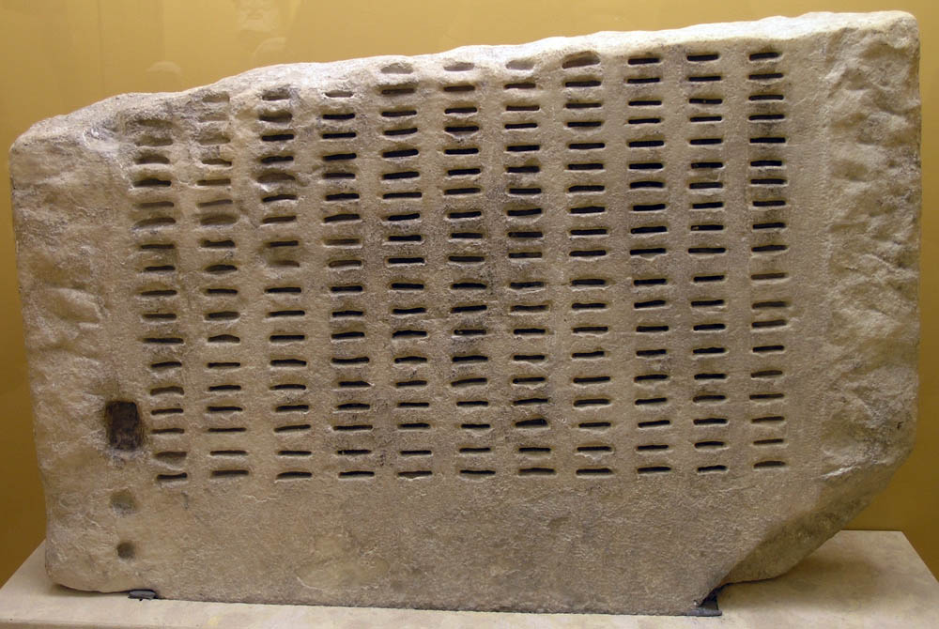
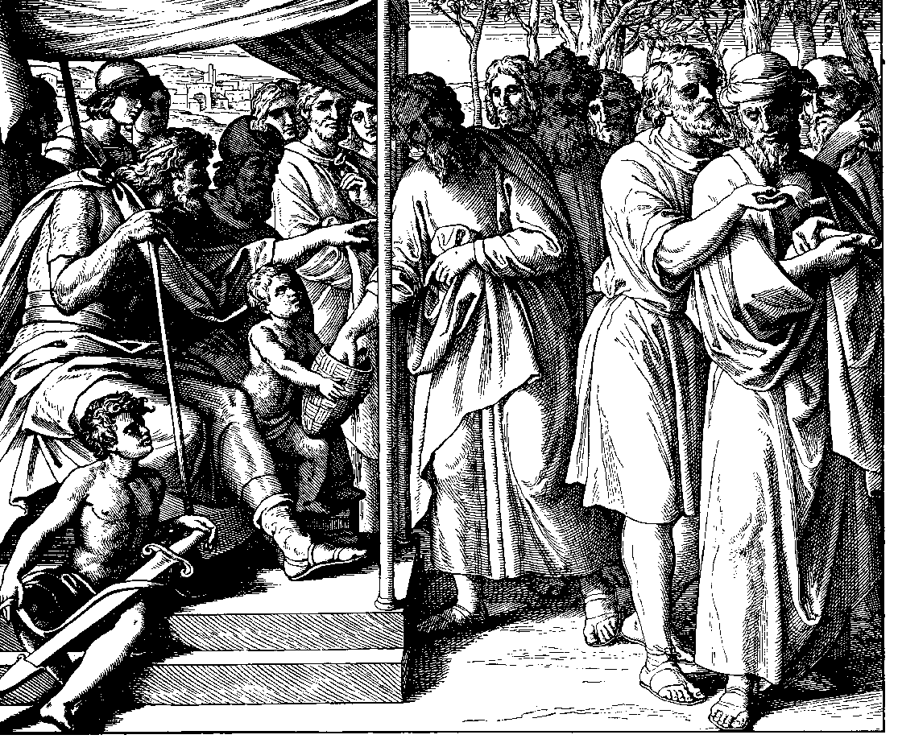

Lottery allocation is an old idea….
kleroterion was a randomisation device used by the Athenian polis during the period of democracy to select citizens to most state offices and to court juries (known as sortition).
Used in the early Christian church to select the twelfth apostle to replace Judas.
Some Orthodox Christian churches still use cleromancy to select religious leaders

Slide 3
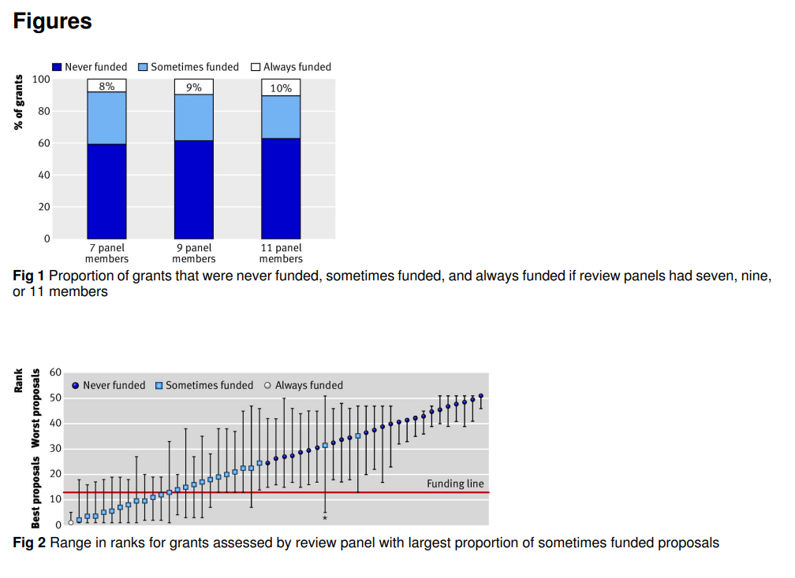
Research funding is already random
Allocating research funding is somewhat subjective ;
If we had a different panel/ reviewers, would the grant have been funded/ not funded?;
National Health Medical Research Council (NHMRC) gave us anonymised data on Grant Review Panel Scores
Were able to statistically measure the probability of grants being funded based on variation in panel scores.
Random element of funding decision and limited budget is a challenge facing many research funders
Graves N, Barnett A G, Clarke P. Funding grant proposals for scientific research: retrospective analysis of scores by members of grant review panel BMJ 2011; 343 :d4797 doi:10.1136/bmj.d4797

Slide 4

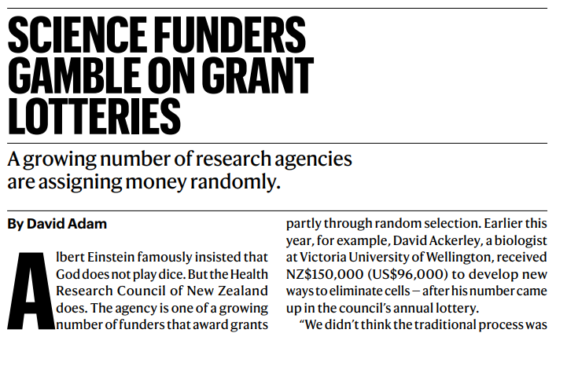

Growing use of modified lotteries in research funding
New Zealand Health Research Council were already using a conditional lottery with one of their scheme (Explorer Grants) since 2012 ;
In the last few years many other funders in Europe have tried modified lotteries (eg Swiss National Science Foundation)
In the UK several funders (eg British Academy) & Universities are experimenting with the use of modified lotteries
The idea of lotteries covered in Nature Editorial, but the focus is on allocation rather

Slide 5


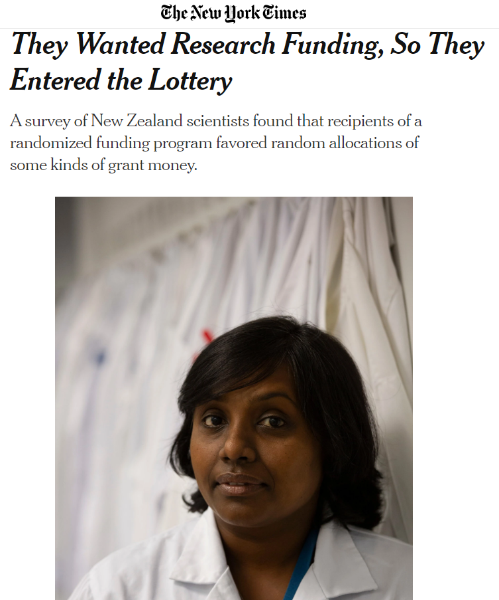
Are researchers happy to be randomized?
We have worked with HRC in NZ to evaluated aspects of the explorer grant scheme which uses a modified lottery since 2013 – eg. acceptability of randomization from an applicants perspective
“There was agreement that randomization is an acceptable method for allocating Explorer Grant funds with 63% (n = 79) in favour and 25% (n = 32) against.”
overall response rate was 39% & are NZ researchers view reflected elsewhere

Slide 6
Why use a conditional lottery?
Change applicant behaviour
Take more risks in the proposal, less “gaming”;
Encourage greater diversity of applicants (new applicants will give it a go, knowing that a traditional system will not rank them the ‘best’)
Efficiency & due process
It may be quicker to evaluate grants, but lotteries may encourage more applicants.
Reduces the potential for bias in the grant review
Opens up the possibility of weighted lotteries to address fairness & distributive justice
Facilitates impact evaluation
Randomised experiments can quantify outcomes

Slide 7
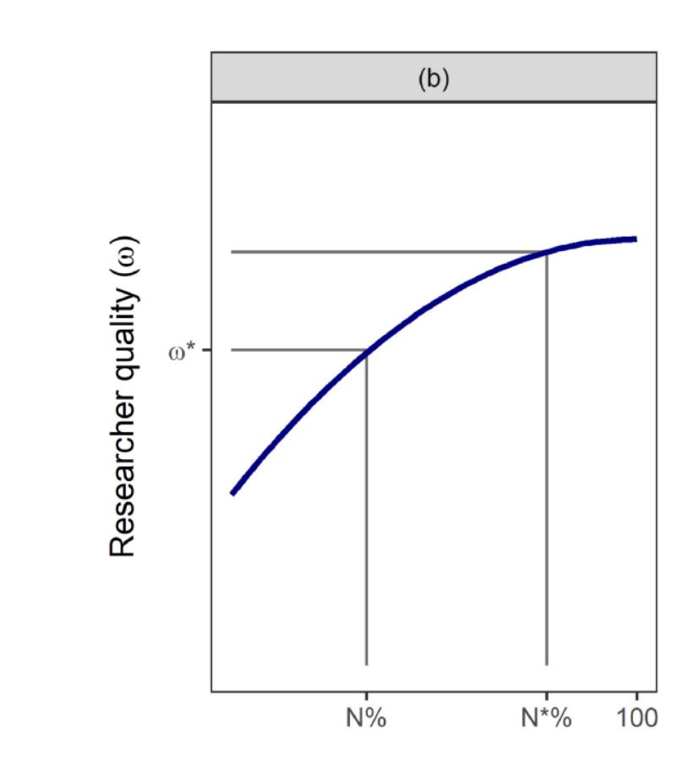
Design of conditional lotteries
Conditions for lotteries
Need to ration among meritorious applicants.
Find the “flat of quality” curve.

Slide 8
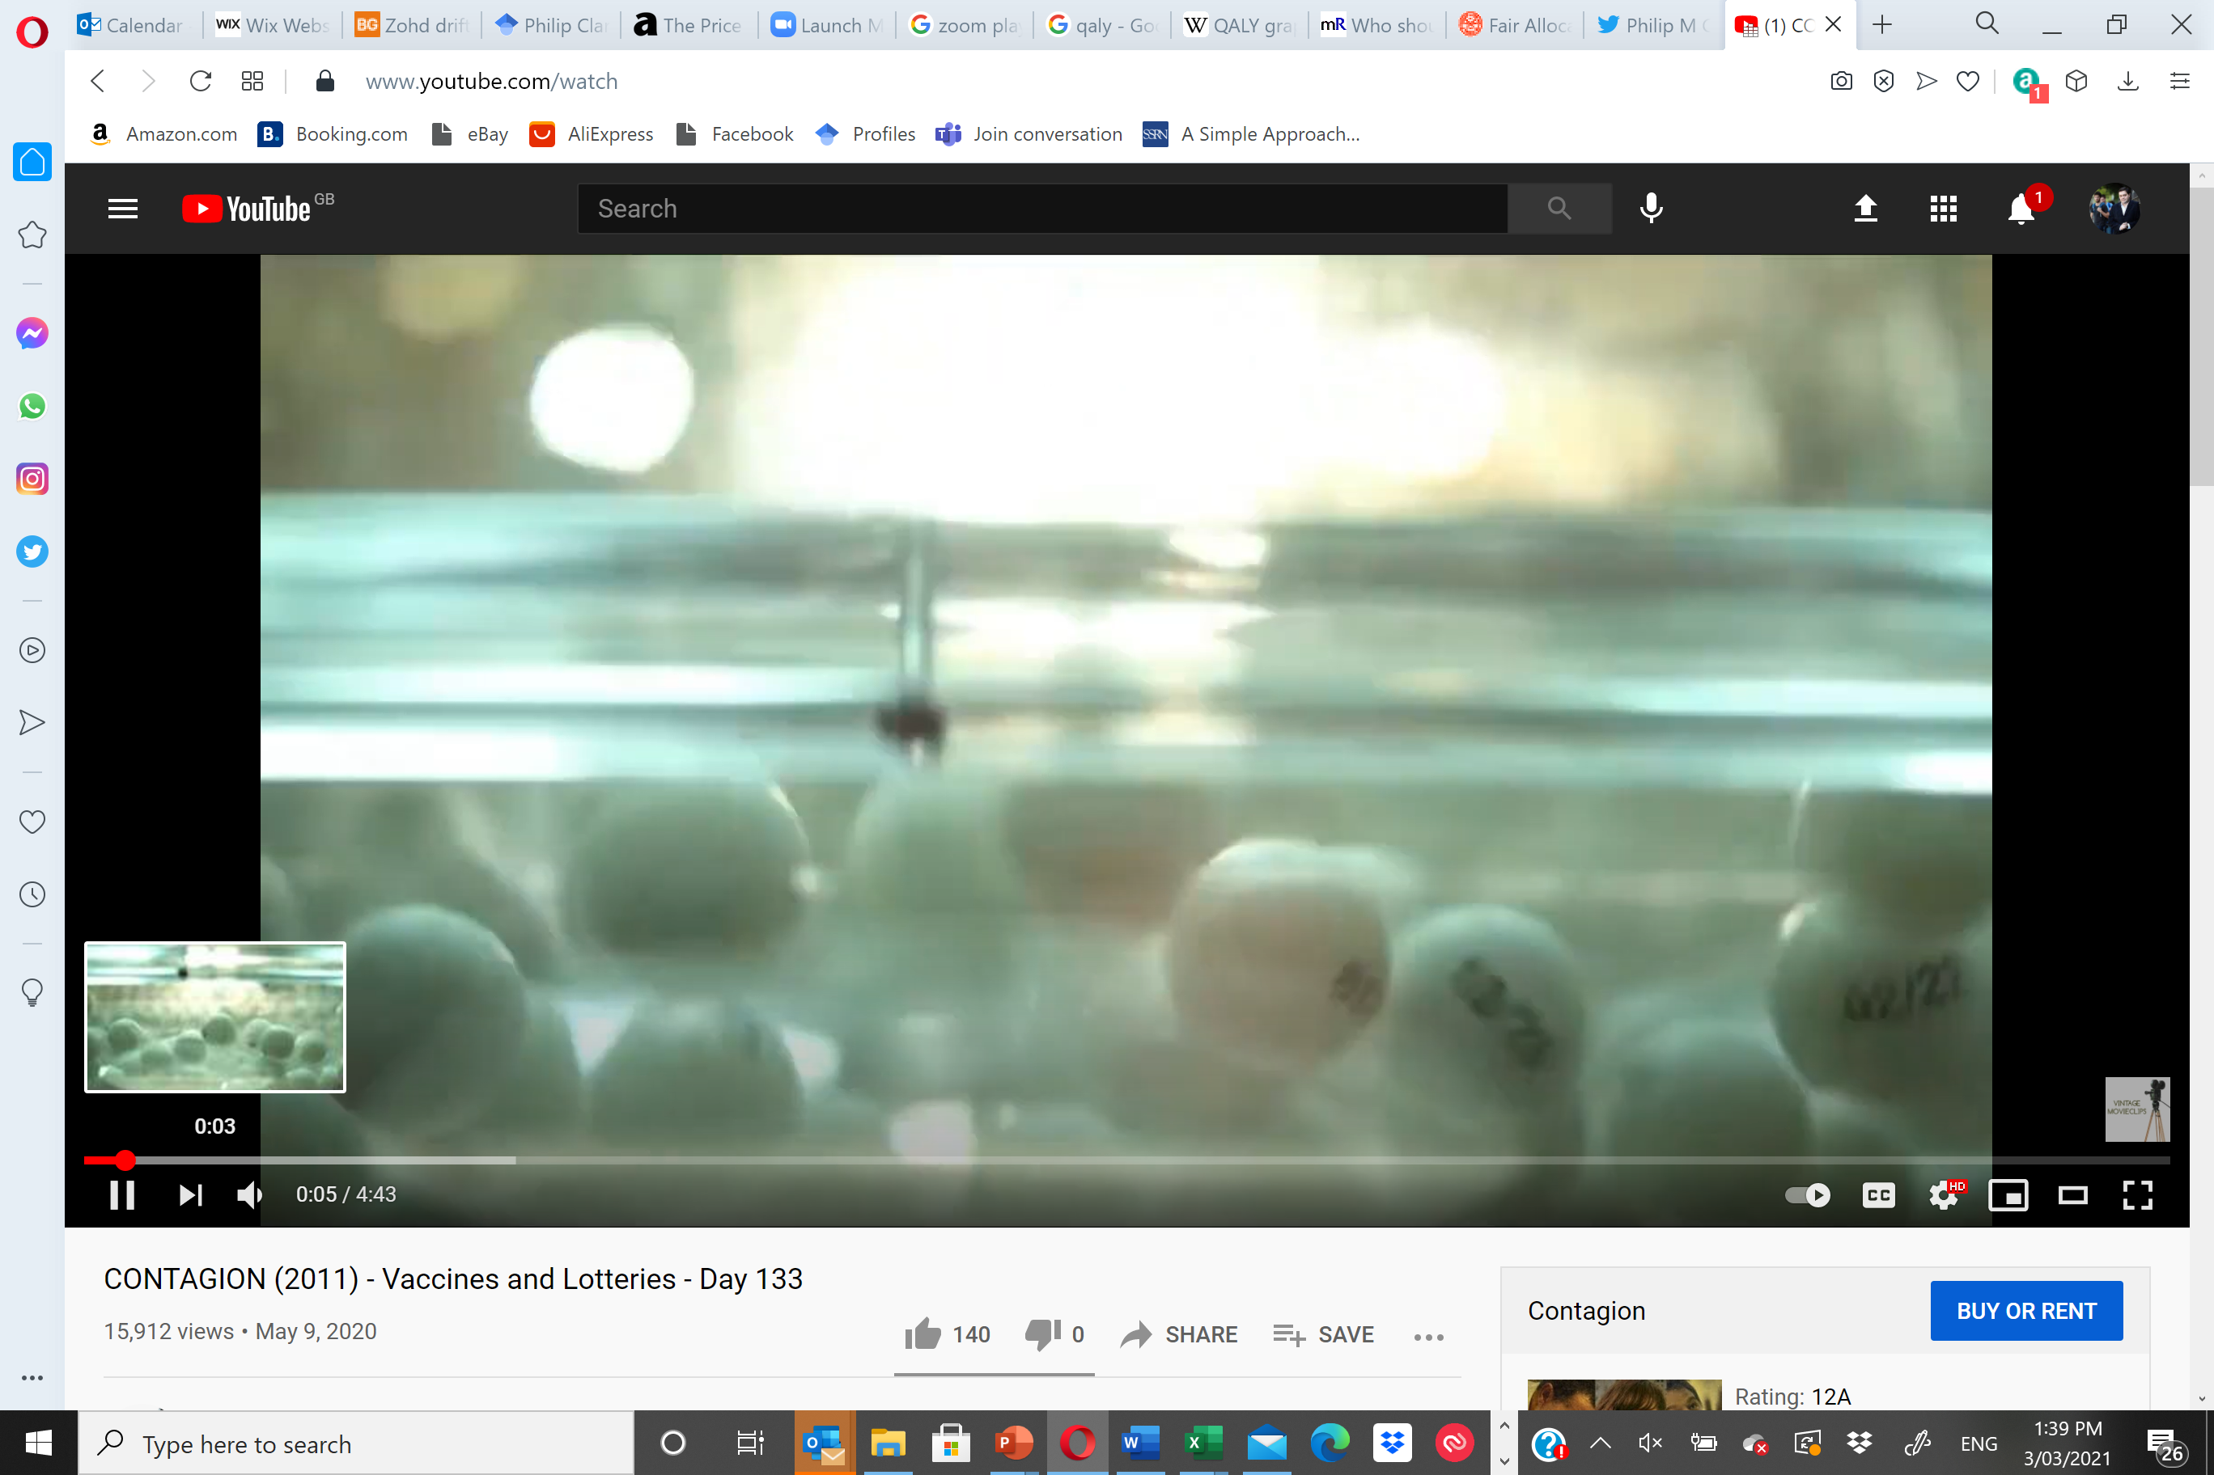
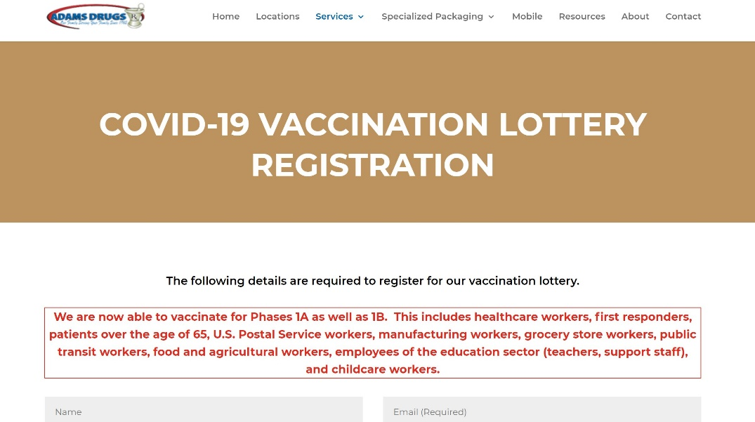
Lottery allocation in other areas: Scare vaccines in a pandemic as seen on TV
In the closing scenes of Contagion, thanks mostly to the efforts of its government-funded doctors and researchers … vaccine is developed, tested, and mass produced…. “It’s gonna start getting normal again,” Matt Damon assures his daughter…. We learn that a birthday-based lottery will be used to deploy the vaccine, with randomly chosen, numbered ping-pong balls read aloud on live television, to most fairly determine who will get treated first.
The idea of such an easy, structured ending is borderline comical.
JAN. 30, 2020 Jason Bailey re-review of Contagion

Slide 9
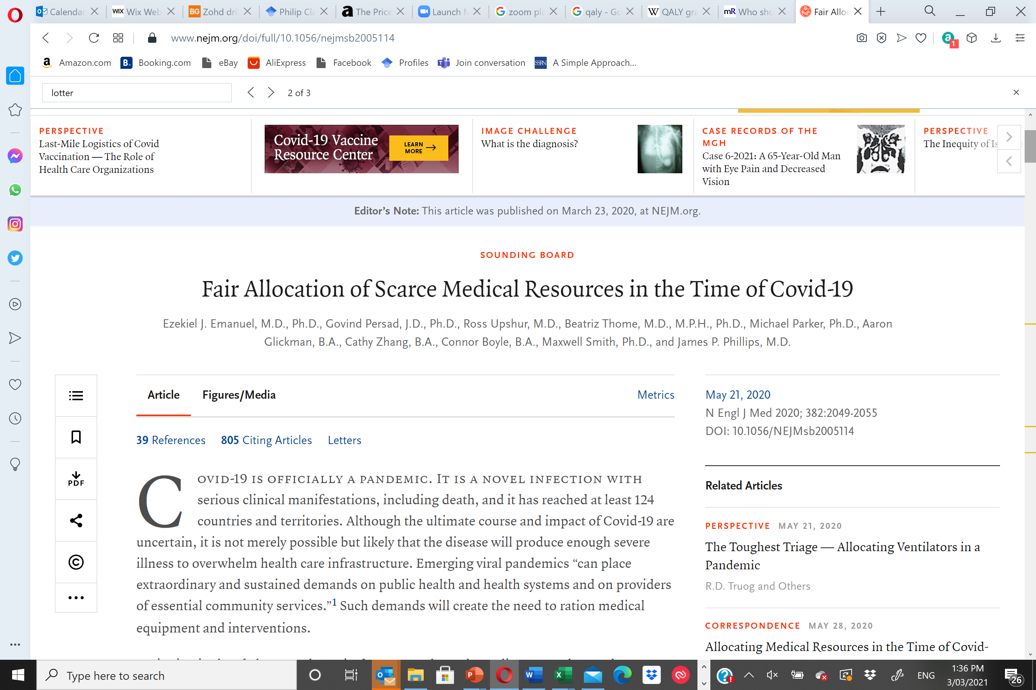
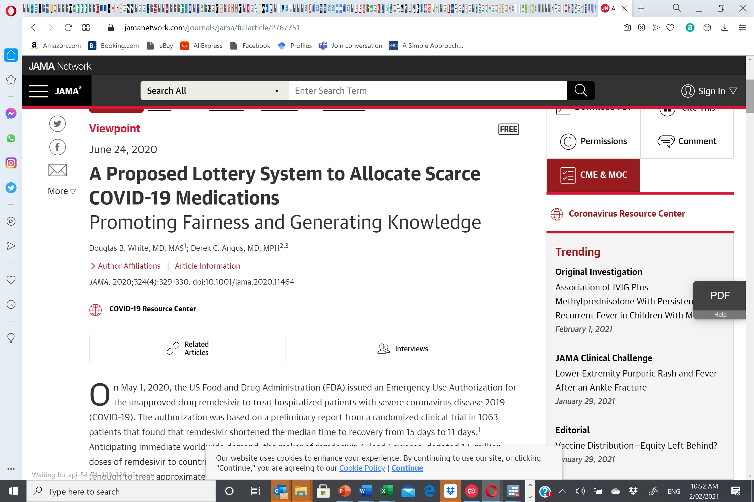
Ethical basis of random allocation
Recommendation 3: For patients with similar prognoses, equality should be invoked and operationalized through random allocation, such as a lottery, rather than a first-come, first-served allocation process.

Slide 10
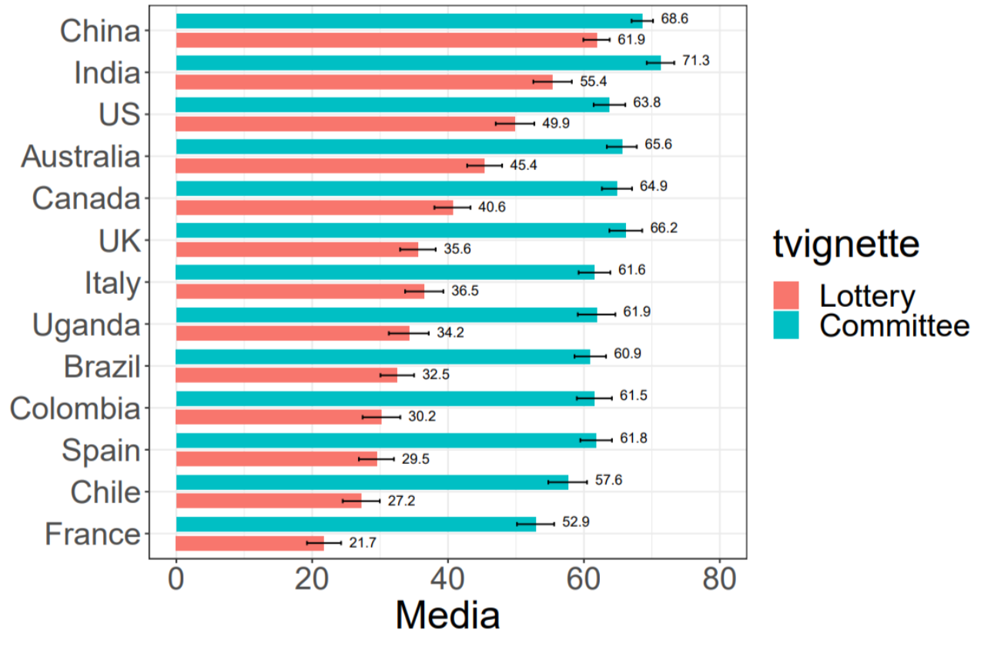
Public “agreement” with using lotteries varied widely across the world

Slide 11
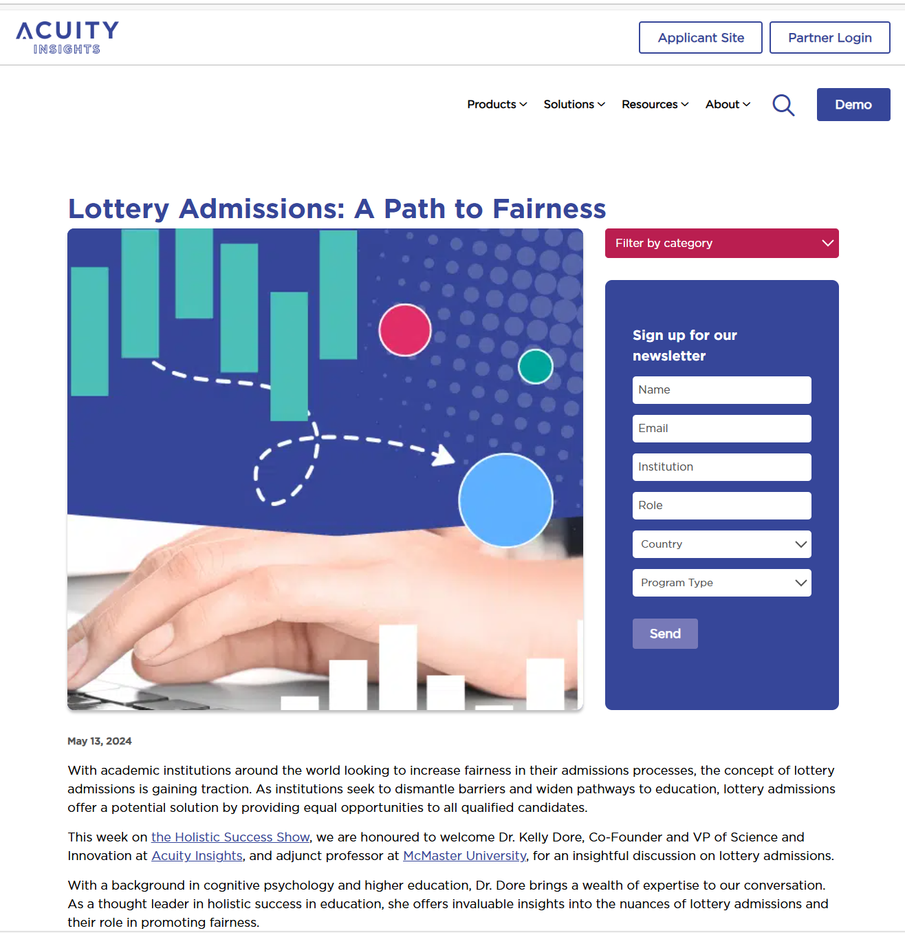
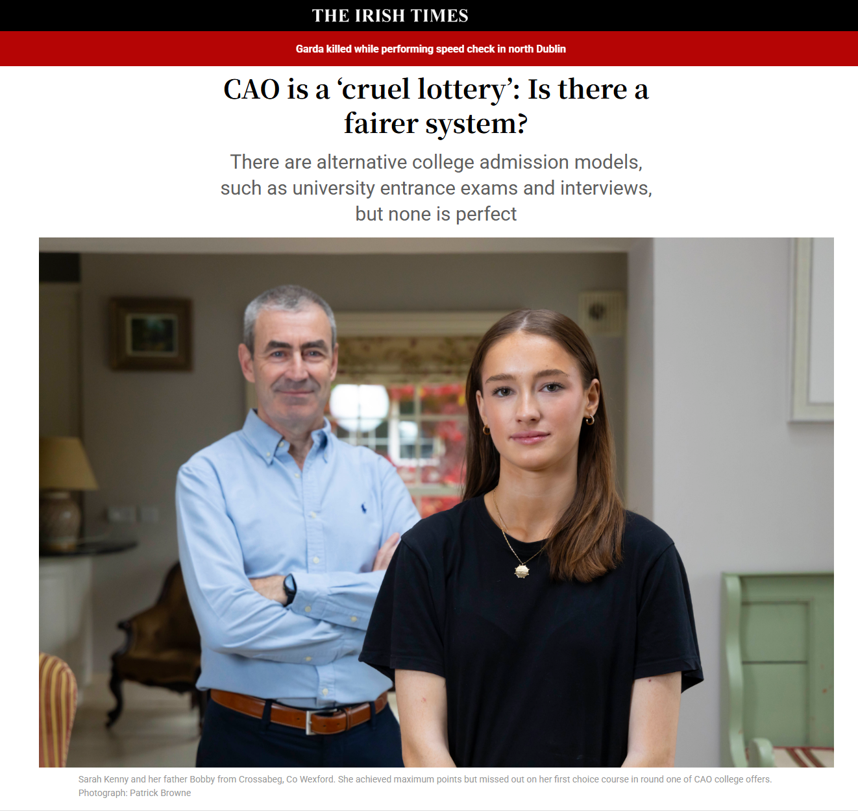
Medical student places in Ireland

Slide 12
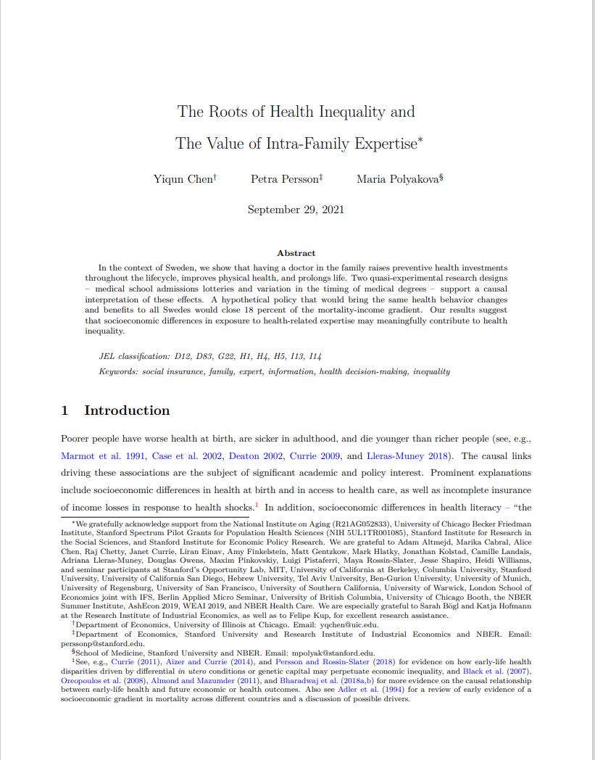
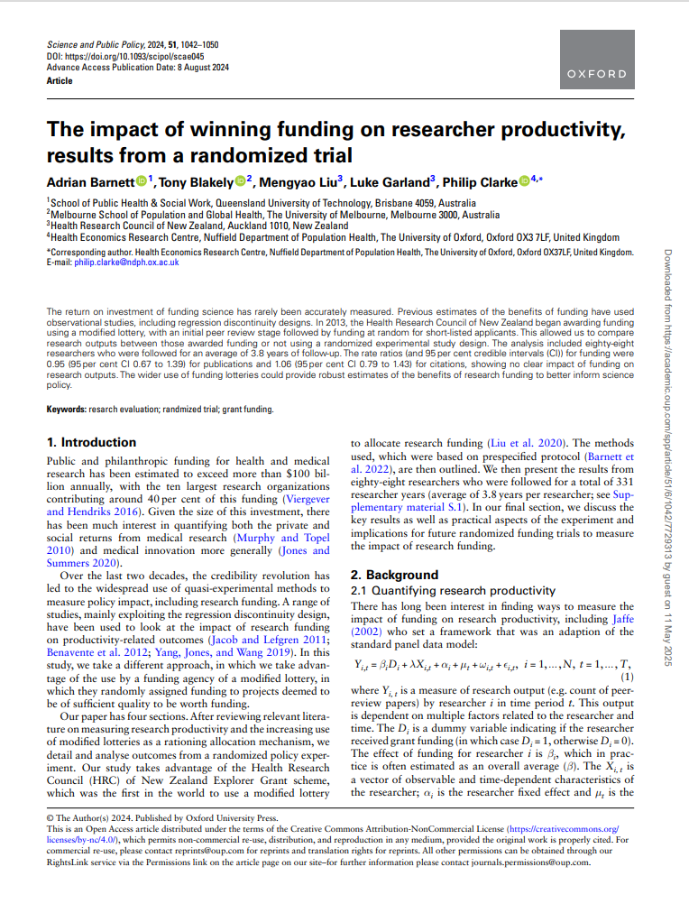
Impact evaluation

Slide 13

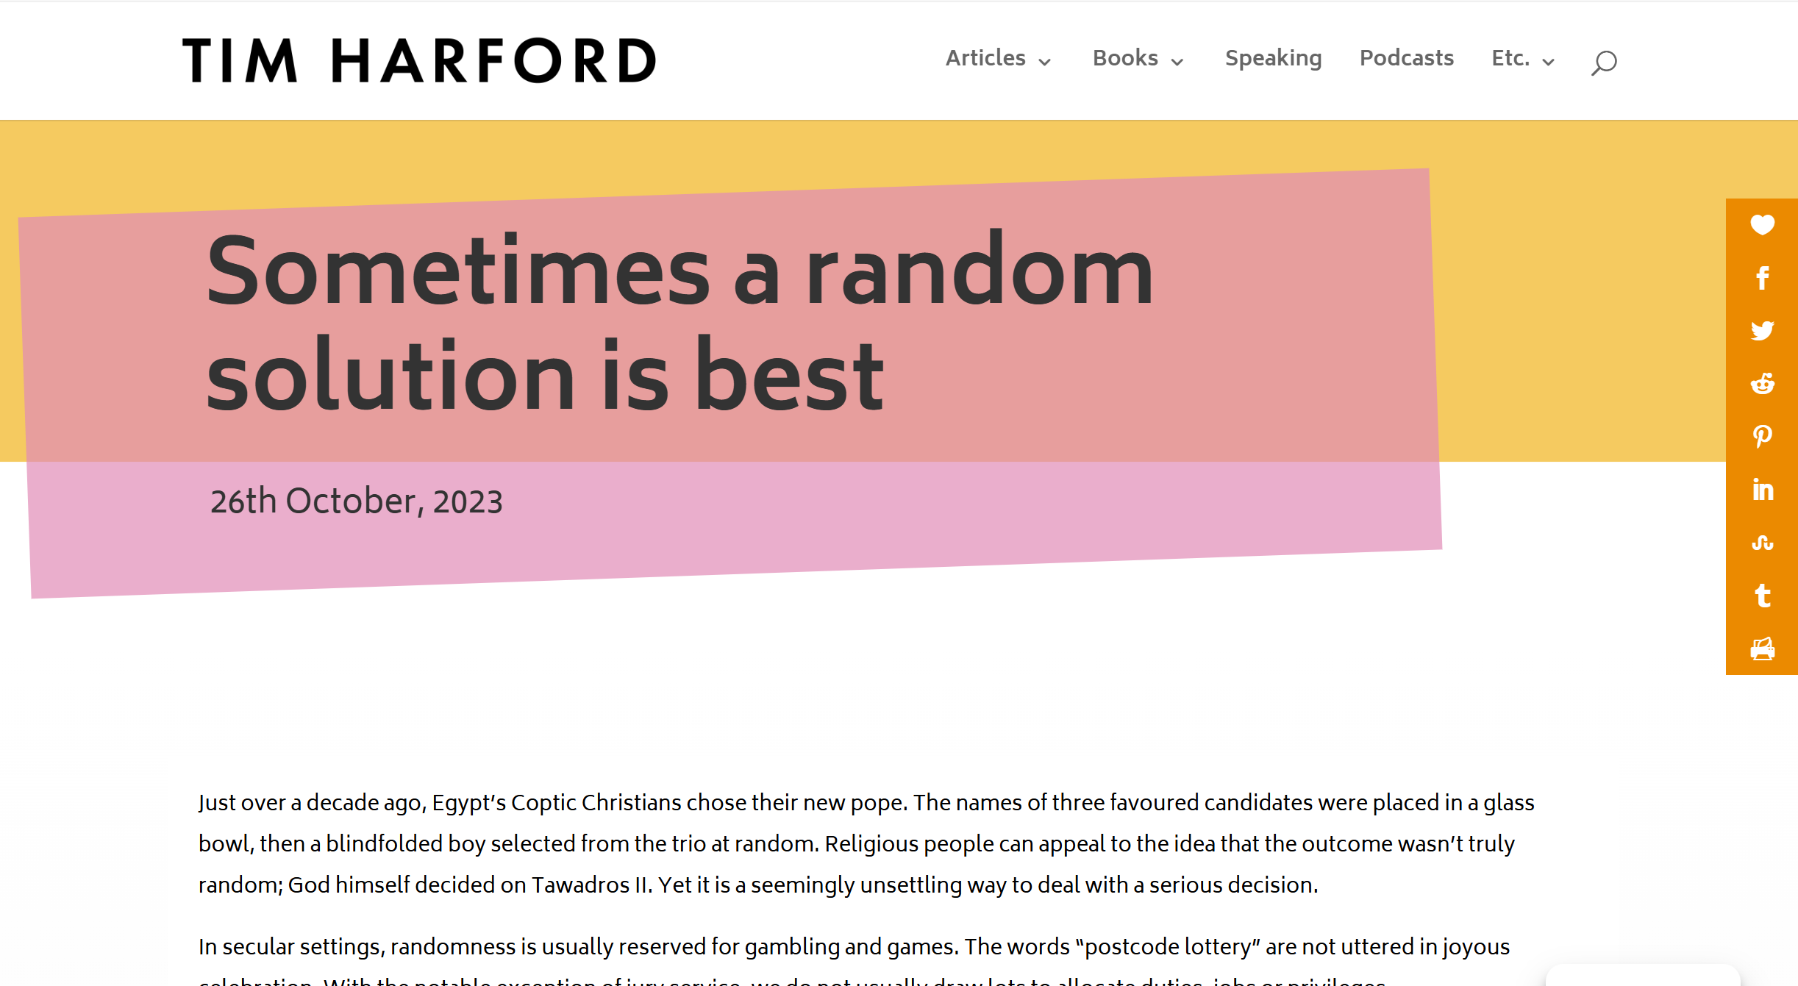
From fringe to mainstream?

Slide 14
Aims of the day
Review real-world examples and potential applications of lotteries across education, research, and public policy.
Discuss the implementation of conditional lotteries allocating scarce public resources in Australia & building trust of applicants & public engagement.
Map out how conditional lotteries can support rigorous evaluation through randomised trials and expand the impact evaluation of public (and privately) allocated resources

Slide 15

Outline of the day

